Slide 1

Salmon vs STAR
ANGSD Project Presentation
Mohith Arikatla
MS Computational Biology 24’
April 25th, 2023

Slide 2
Project learning objectives
End-to-end NGS Data Analysis
Formulating and testing a strategy
Learn to manage and process sequencing data
Evaluate the quality of the data at all stages
Interpret results
Document the process (with an emphasis on reproducibility)

Slide 3
The Question
Hypothesis: There will be a significant difference in the enriched pathways when different quantification algorithms are used. (Classical alignment vs Pseudo-mapping Algorithm)
Method: Obtain feature count data using an alignment algorithm and a pseudo-mapping algorithm and process them in the same way to perform pathway analysis and then compare the enriched pathways

Slide 4
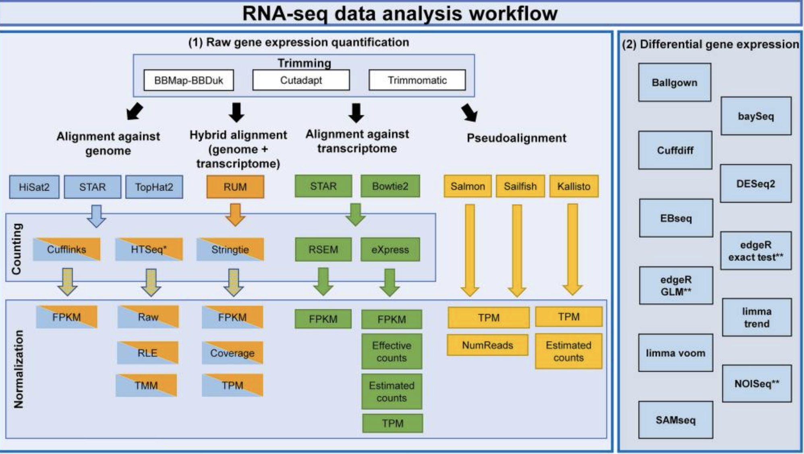
Decisions Decisions
Which pipeline do I use?
How long do you have?
What is your end goal?
Corchete et al., 2020
Notes:
Corchete LA, Rojas EA, Alonso-López D, De Las Rivas J, Gutiérrez NC, Burguillo FJ. Systematic comparison and assessment of RNA-seq procedures for gene expression quantitative analysis. Sci Rep. 2020;10(1):19737. Published 2020 Nov 12. doi:10.1038/s41598-020-76881-x

Slide 5
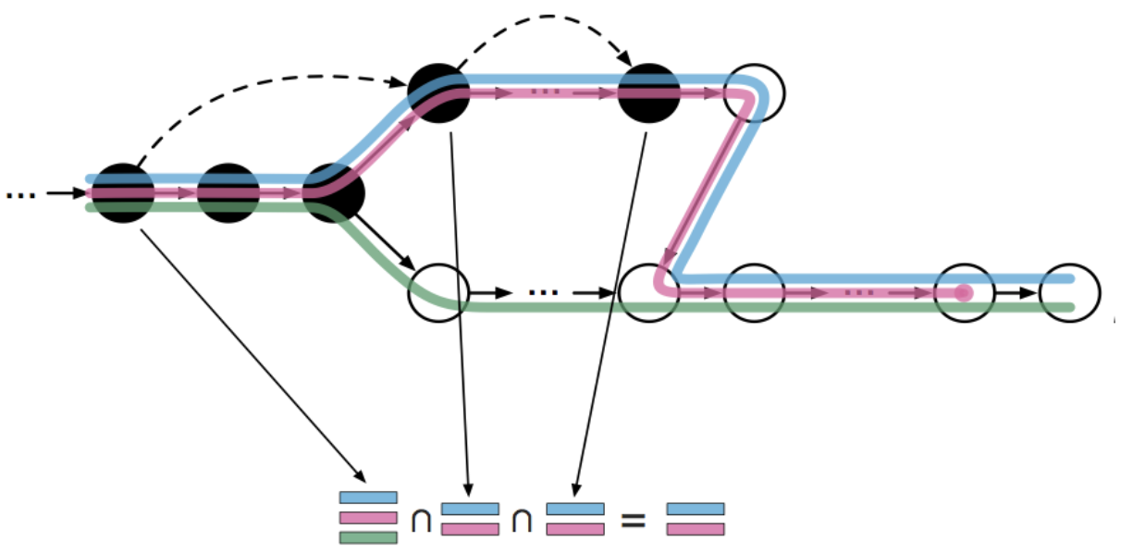
What is pseudo-alignment?
It’s NOT necessary to do a full alignment of the reads to the genome which is often the slowest step in sequencing analysis
Instead, the raw sequence reads are directly compared to transcript sequences and then used to quantify transcript abundance
Pseudo-aligners have an advantage in terms of the time of computation through skipping redundant hash-mappings
https://tinyheero.github.io/2015/09/02/pseudoalignments-kallisto.html

Slide 6
Comparison
Feature | Salmon | STAR
Genome Reference |  | x
Transcriptome Reference | x | x
Needs annotation | x
Alignment |  | x
Pseudo-alignment (Only quantification) | x | x
Expression Values | x | x
Splice aware |  | x

Slide 7

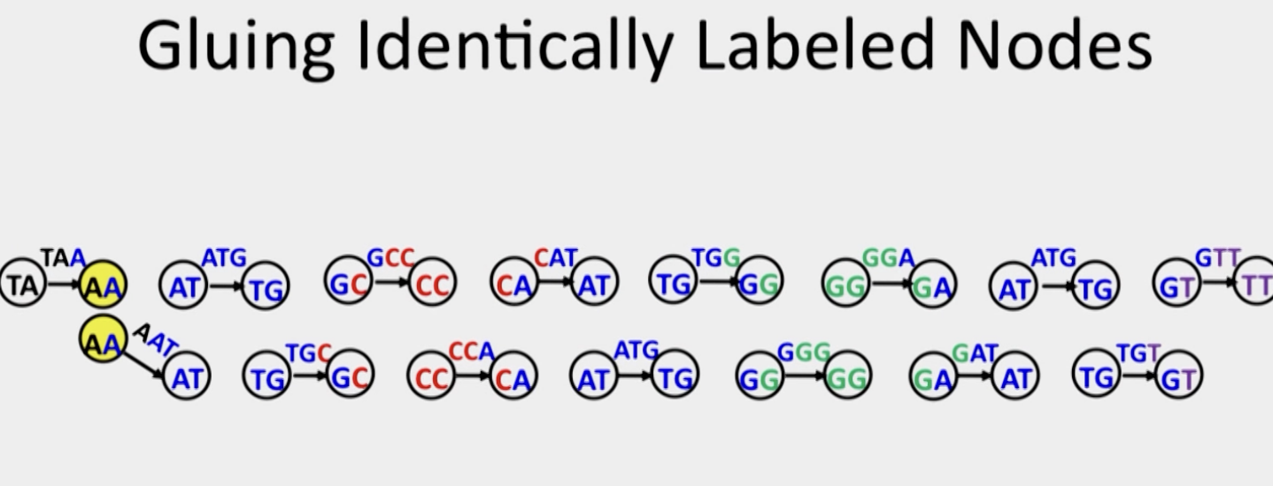
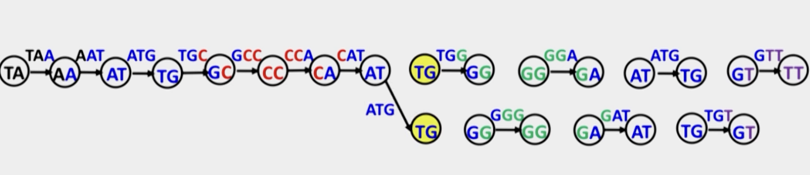
Why does Salmon need a transcriptome?

Slide 8
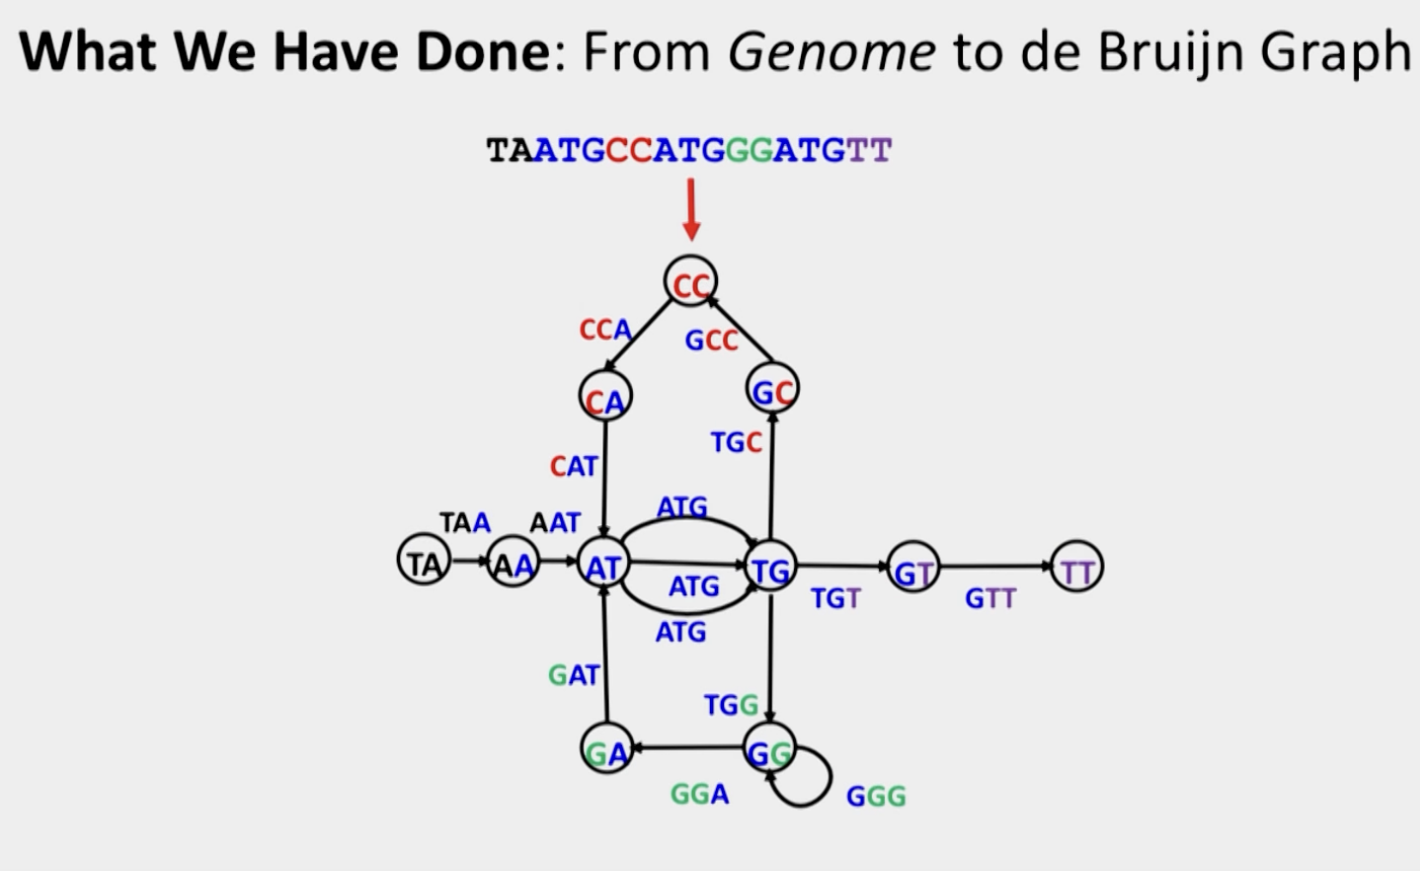
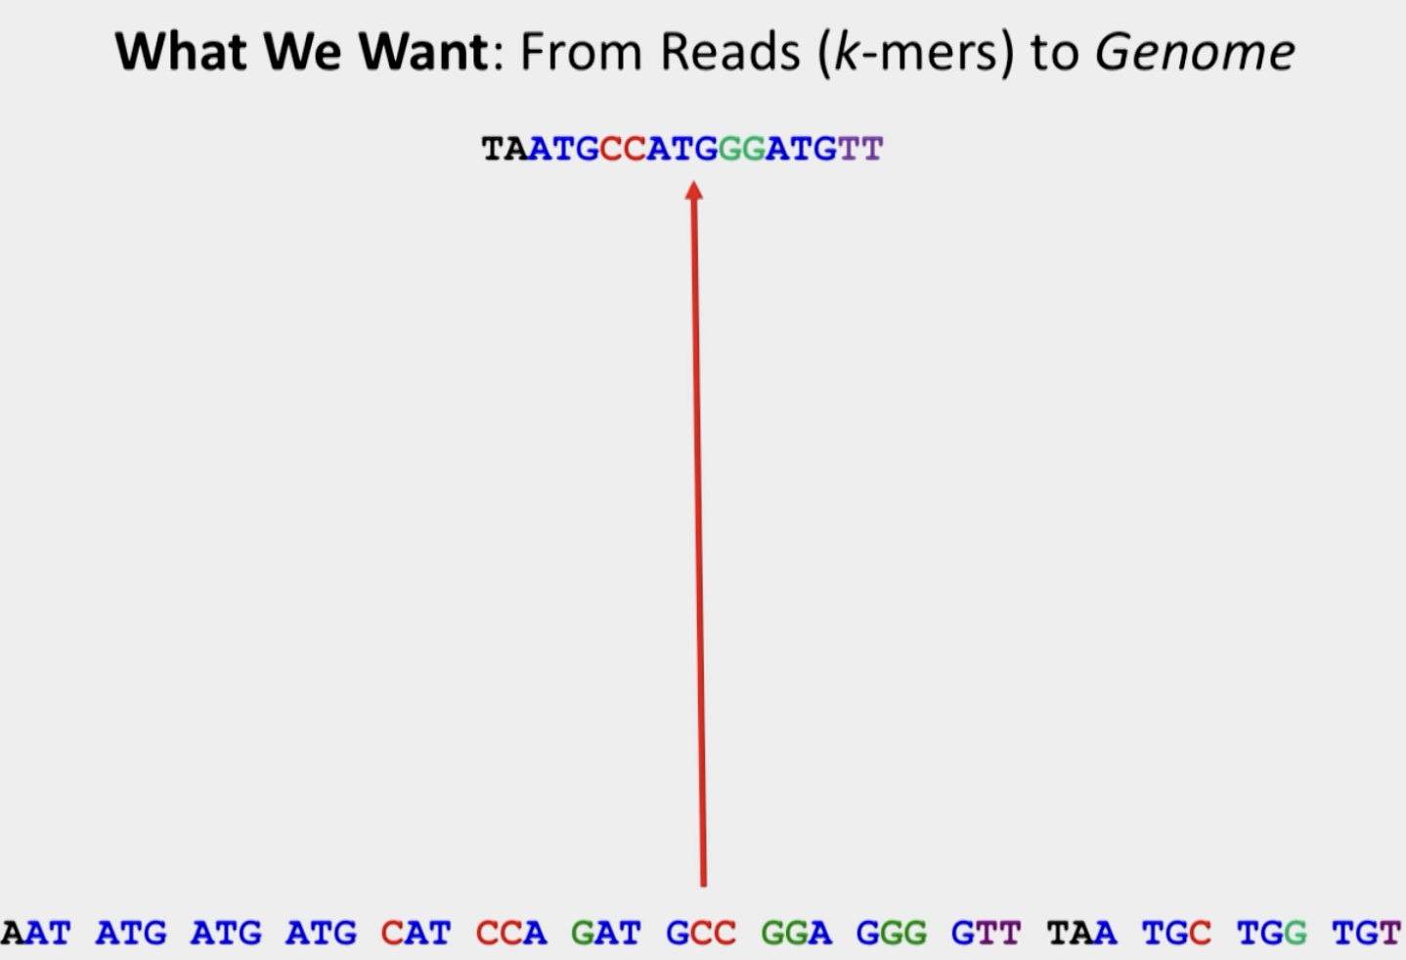
Why does Salmon need a transcriptome?

Slide 9
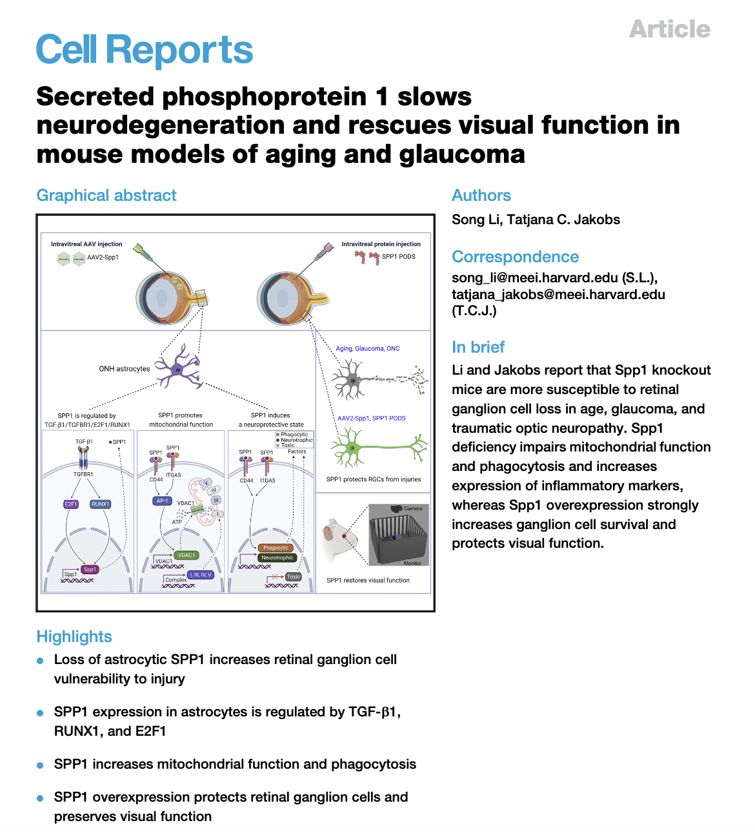
Dataset
Experimental design: Astrocytes mRNA profiles of wild type and Spp1 KO neonatal mice
Sequencing - Illumina NovaSeq 6000
Alignment (GRCm38) - STAR software package
Differential expression analysis - DESeq2
Results:
Reads obtained - 40 million raw reads per sample
DEGs - 3624 (fold change ≥1.5 and p value <0.05)
1991 were upregulated and 1633 were downregulated in the Spp1−/− astrocytes

Slide 10
Rationale
Aging in CNS causes loss of photoreceptors and retinal ganglion cells.
Mice lose 7,000-50,000 RGCs/year
Degenerative diseases like Glaucoma exhibit a pathophysiology resembling natural aging and expedite this rate of neuron degeneration
Aging glial cells resemble reactive-astrocytes
An age-related decrease in the phagocytic capacity of astrocytes may contribute to accumulation of damaged mitochondria in RGCs themselves
Notes:
Glaucoma is characterized by progressive apoptotic loss of RGCs and degeneration of the optic nerve.6 Elevated intraocular pressure (IOP), genetic factors, and age are the most important risk factors
Glial cells are a type of cell that provides physical and chemical support to neurons and maintain their environment. Located in the central nervous system and peripheral nervous system, glial cells are sometimes called the "glue" of the nervous system, as well as neuroglia or just glia.
Astrocytes are a subtype of glial cells that make up the majority of cells in the human central nervous system (CNS). They perform metabolic, structural, homeostatic, and neuroprotective tasks such as clearing excess neurotransmitters, stabilizing and regulating the blood-brain barrier, and promoting synapse formation.
Reactive astrocytes are astrocytes that undergo morphological, molecular, and functional changes in response to pathological situations in surrounding tissue (that is, due to CNS disease, injury, deleterious experimental manipulation).

Slide 11
Observations
The loss of SPP1 leads to a/an
premature aging phenotype in the visual system of mice that is characterized by up-regulation of inflammatory markers
decreased mitochondrial and phagocytic function of astrocytes
increased vulnerability to glaucomatous RGC loss
accelerated age-related decline in vision
Overexpression of SPP1 in the retina and optic nerve head of normal C57BL/6 mice apparently slows aging in the visual system, protects RGCs, and restores vision in several models of optic nerve damage
Notes:
Glaucoma is characterized by progressive apoptotic loss of RGCs and degeneration of the optic nerve.6 Elevated intraocular pressure (IOP), genetic factors, and age are the most important risk factors
Glial cells are a type of cell that provides physical and chemical support to neurons and maintain their environment. Located in the central nervous system and peripheral nervous system, glial cells are sometimes called the "glue" of the nervous system, as well as neuroglia or just glia.
Astrocytes are a subtype of glial cells that make up the majority of cells in the human central nervous system (CNS). They perform metabolic, structural, homeostatic, and neuroprotective tasks such as clearing excess neurotransmitters, stabilizing and regulating the blood-brain barrier, and promoting synapse formation.
Reactive astrocytes are astrocytes that undergo morphological, molecular, and functional changes in response to pathological situations in surrounding tissue (that is, due to CNS disease, injury, deleterious experimental manipulation).

Slide 12
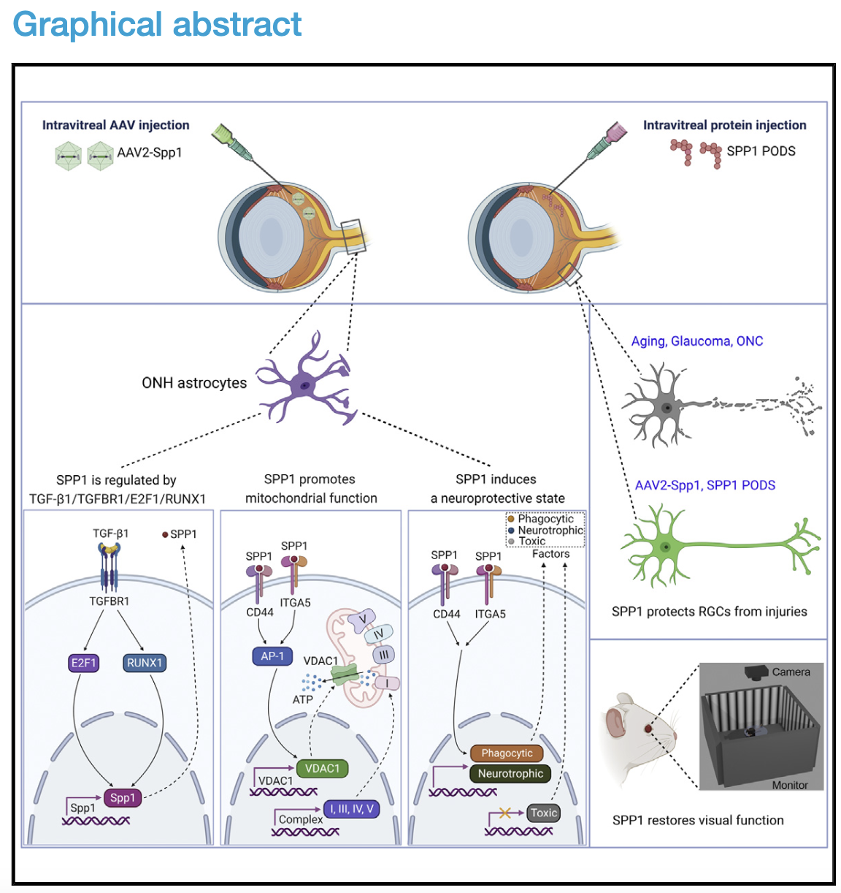
Results of the study
AAV - Adeno-associated virus
SPP1 PODS - Intravitreal delivery of a slow-release SPP1 protein
ONH - Optical Nerve Head
Spp1 deficiency prevented the injury-induced increase in Lgals3 expression
The study indicates that SPP1 slows the course of age-related or glaucomatous death of RGCs and the loss of visual function
Notes:
Adeno-associated viruses (AAV) are single stranded DNA viruses that have not been found to cause pathology in humans. The AAV is dependent on helper viruses for replication and for productive infection. AAV contains two genes, rep and cap, that are required for its replication.
Spp1 deficiency prevented the injury-induced increase in Lgals3 expression. In cultured astro- cytes, rSPP1 protein directly up-regulated Lgals3 gene expres- sion almost 2-fold (Figure 4N). In vivo, LGALS3 immunoreactivity was detectable in the ONH and ON of naive C57BL/6 and Spp1 KO mice, but injury-induced up-regulation of LGALS3 was mark- edly reduced in the Spp1 KO

Slide 13
Limitations of the study
Using SPP1 therapeutically requires SPP1 overexpression to be free of negative side effects in the long term
Glaucoma therapy would most likely span decades. Hence, the effect of SPP1 overexpression should also be studied in a long-lived species
SPP1 expression is not restricted to reactive astrocytes. Alpha RGCs and microglia may be additional sources of SPP1
An analysis of conditional Spp1 KO, especially in microglia or alpha RGCs, would be of interest

Slide 14
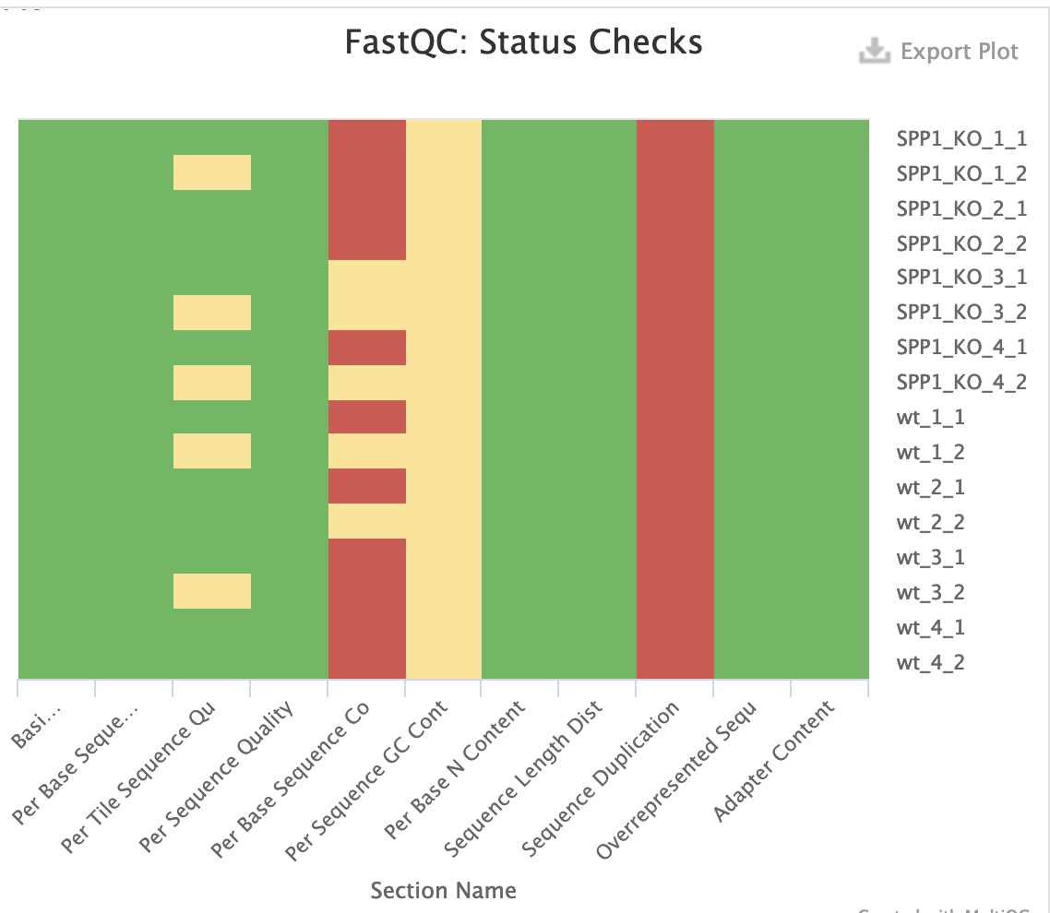
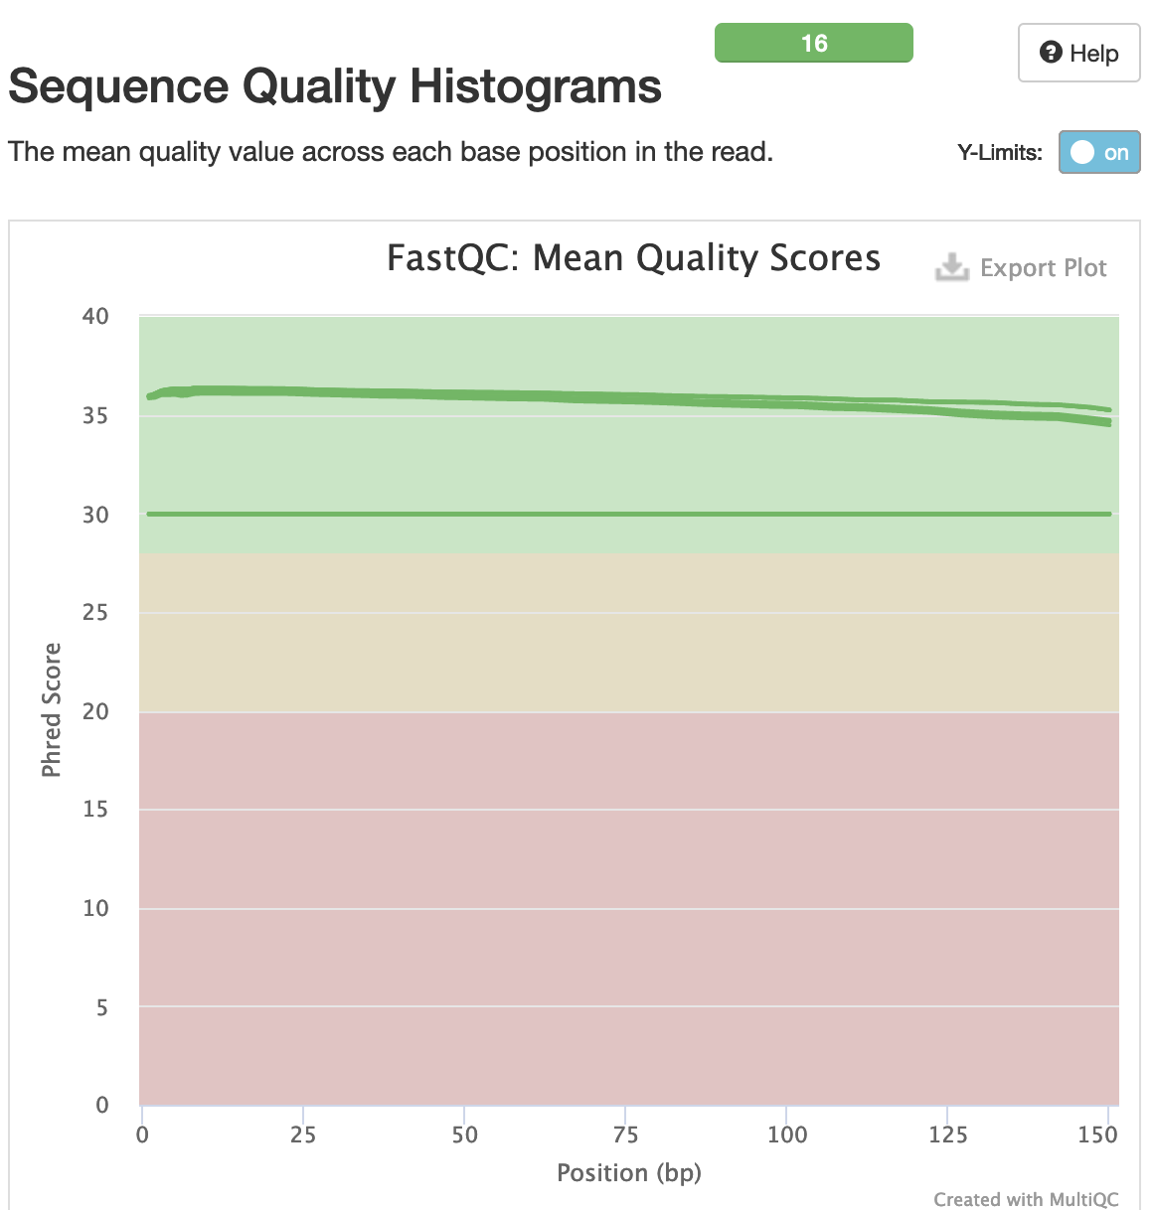
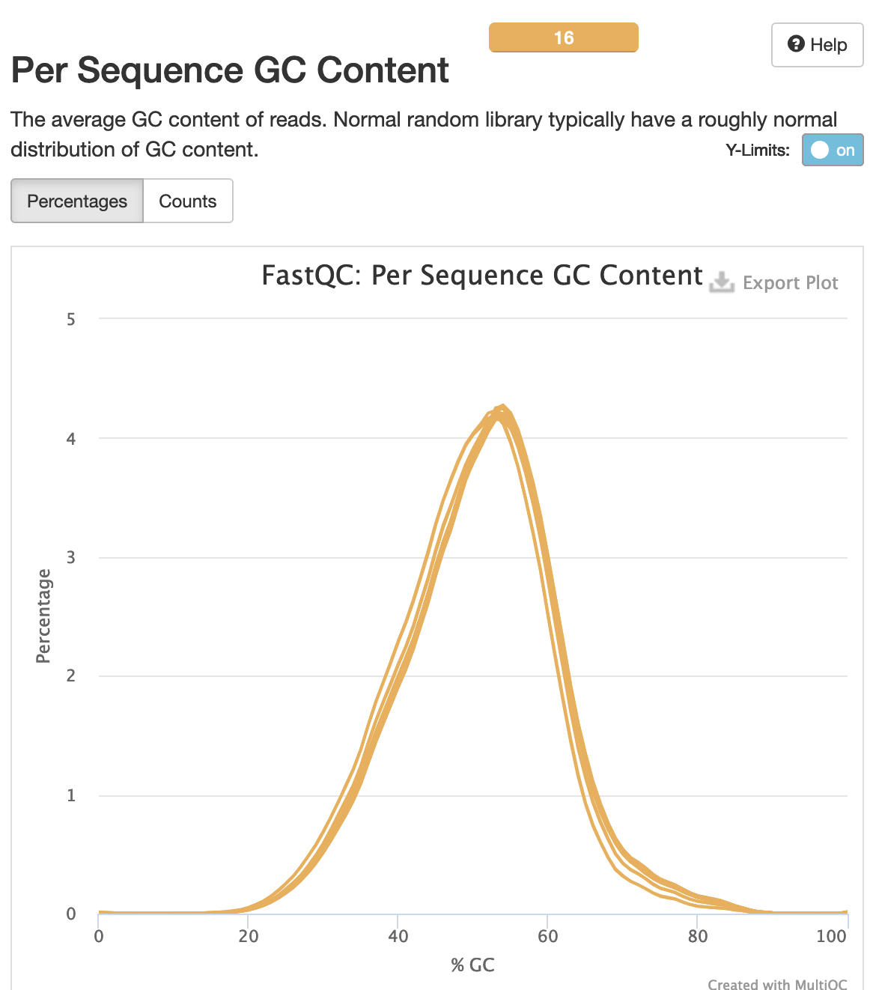
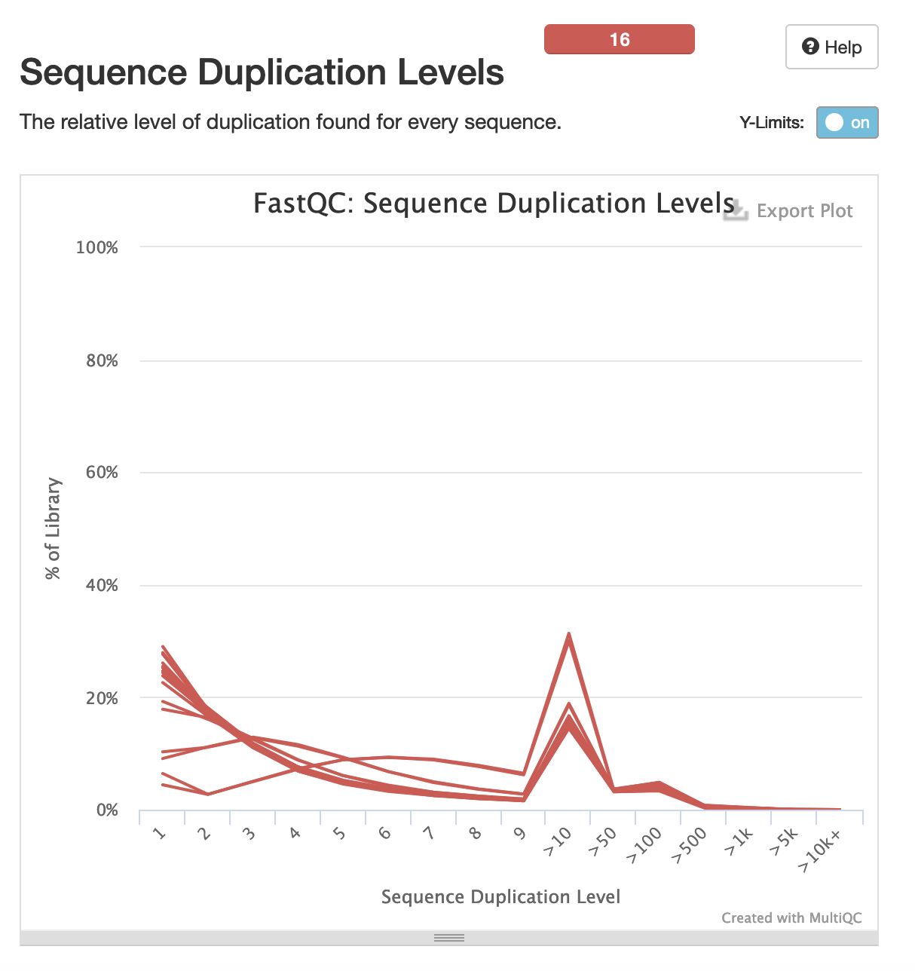
FASTQC

Slide 15
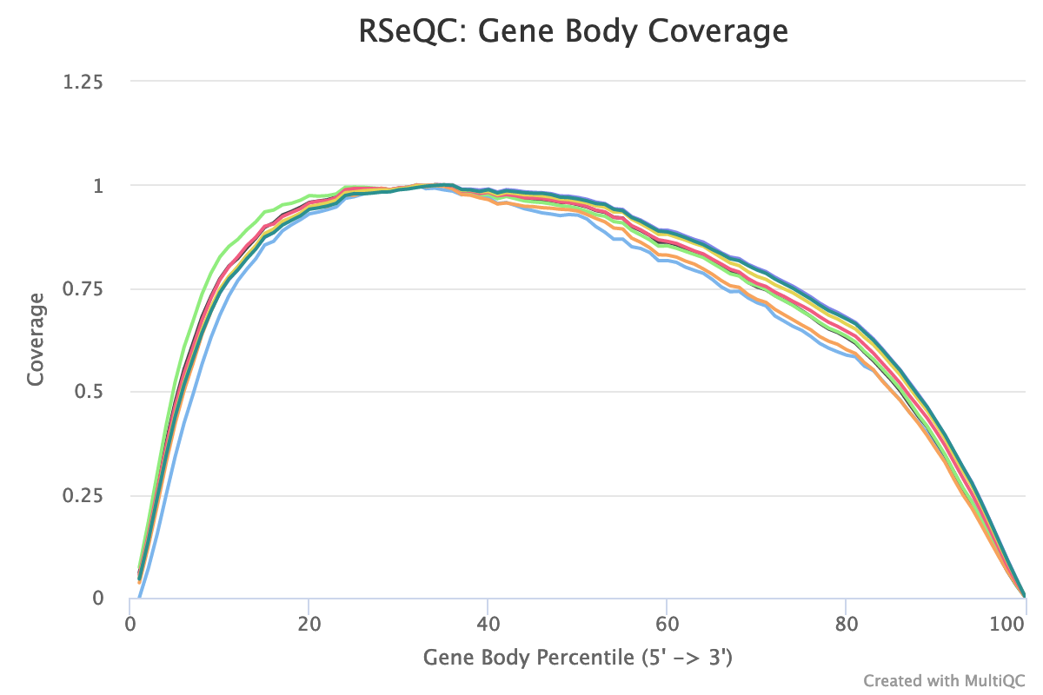
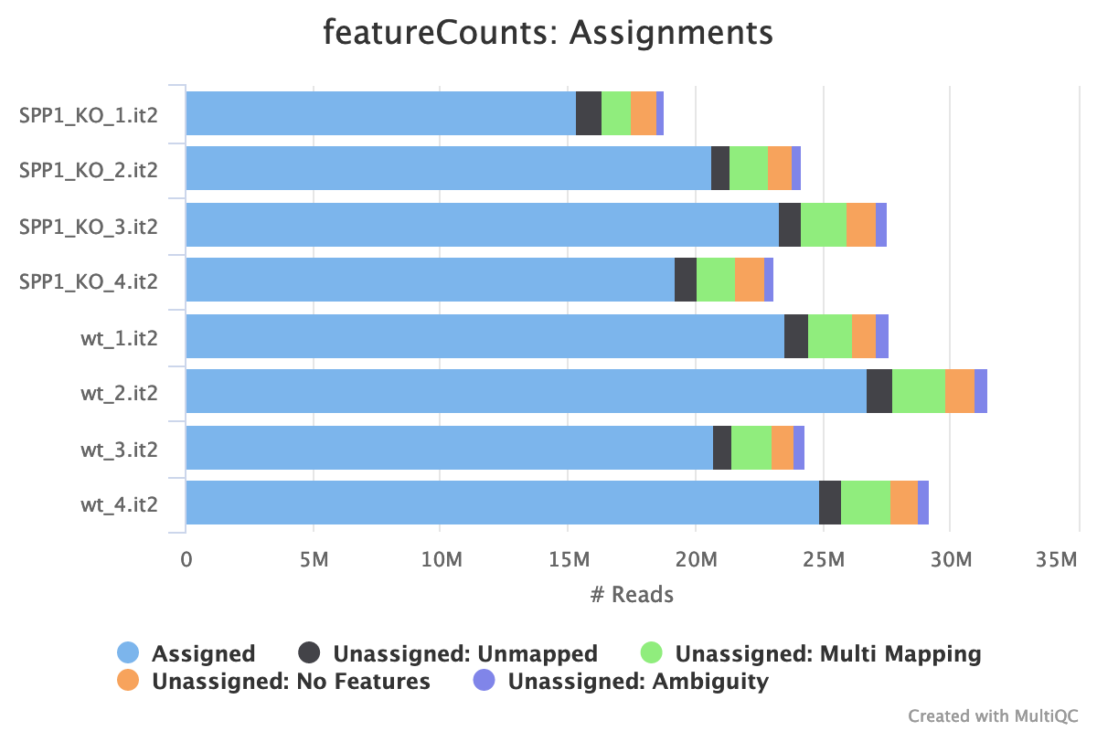
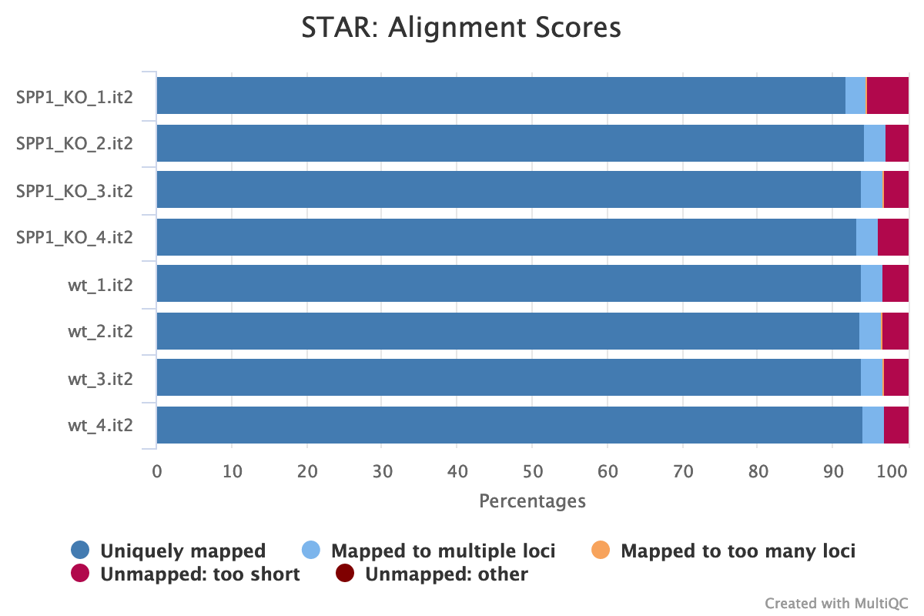
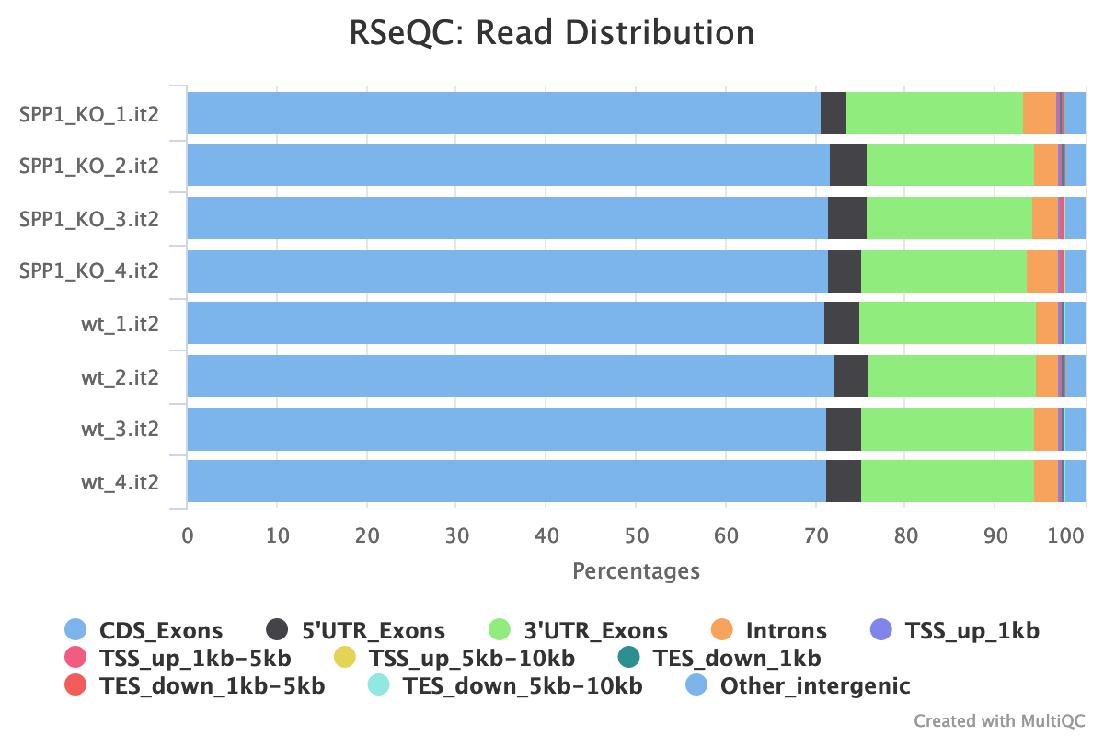
STAR Alignment QC

Slide 16
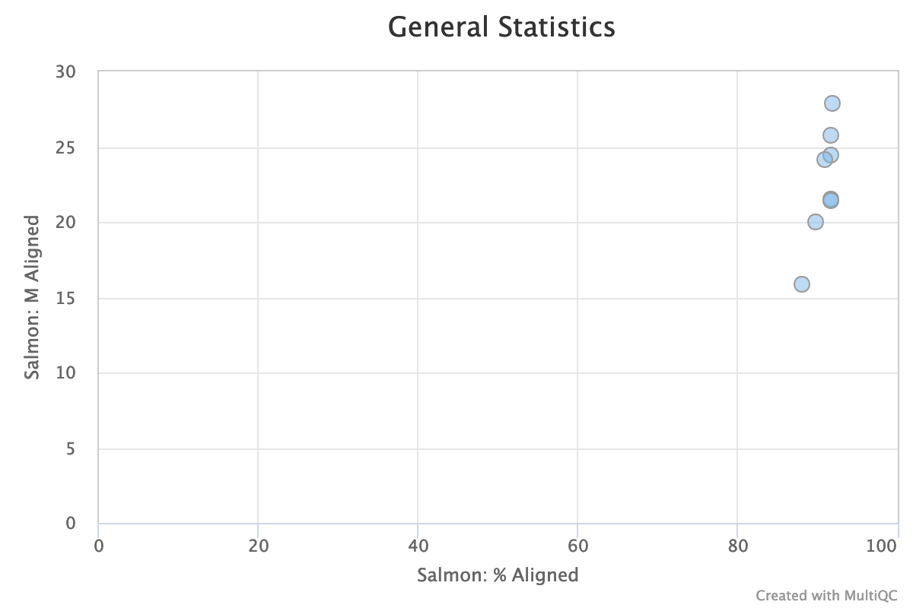
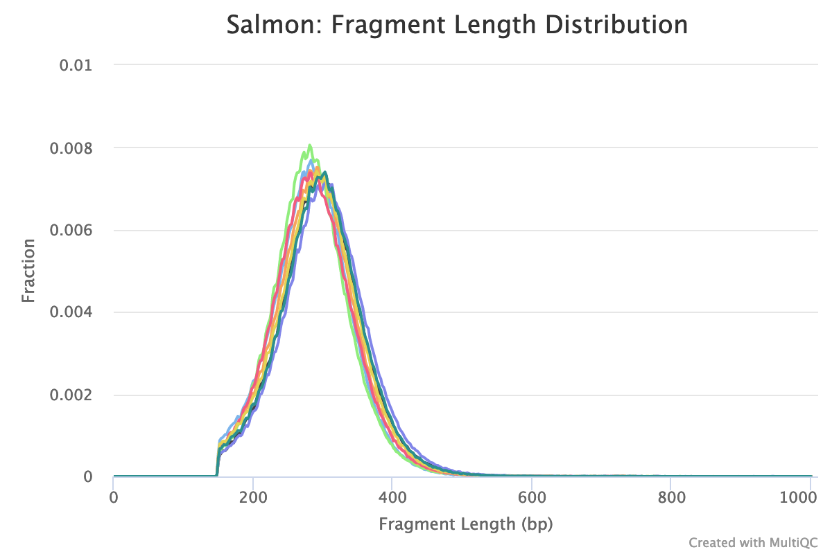
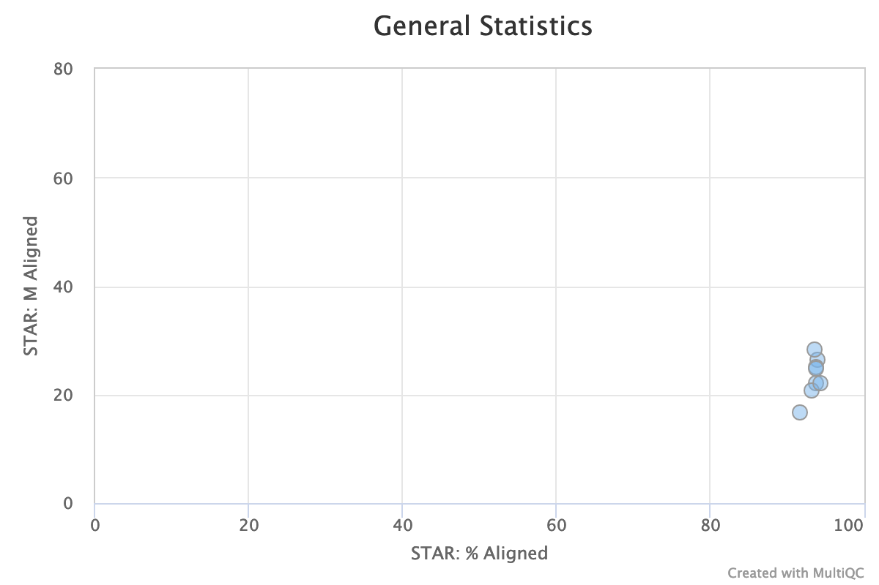
Salmon Quant QC

Slide 17
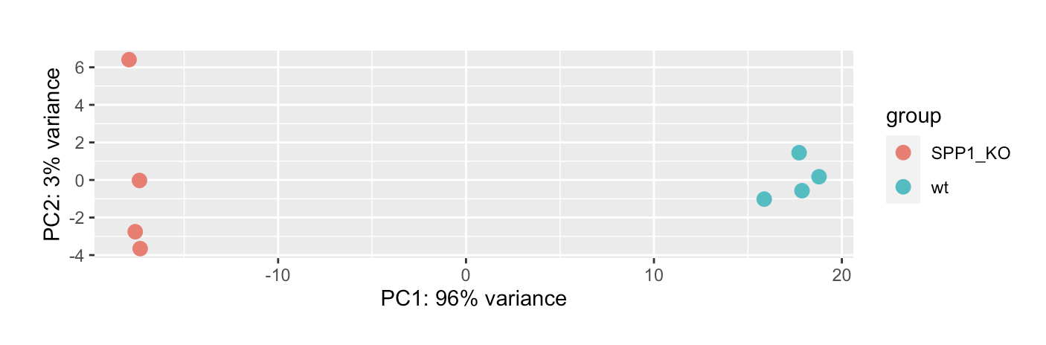
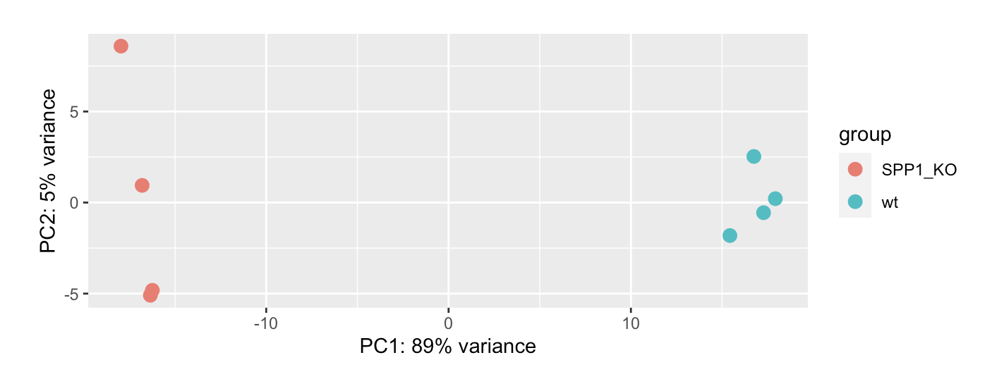
DESeq – Exploratory Data Analysis
STAR
Salmon

Slide 18
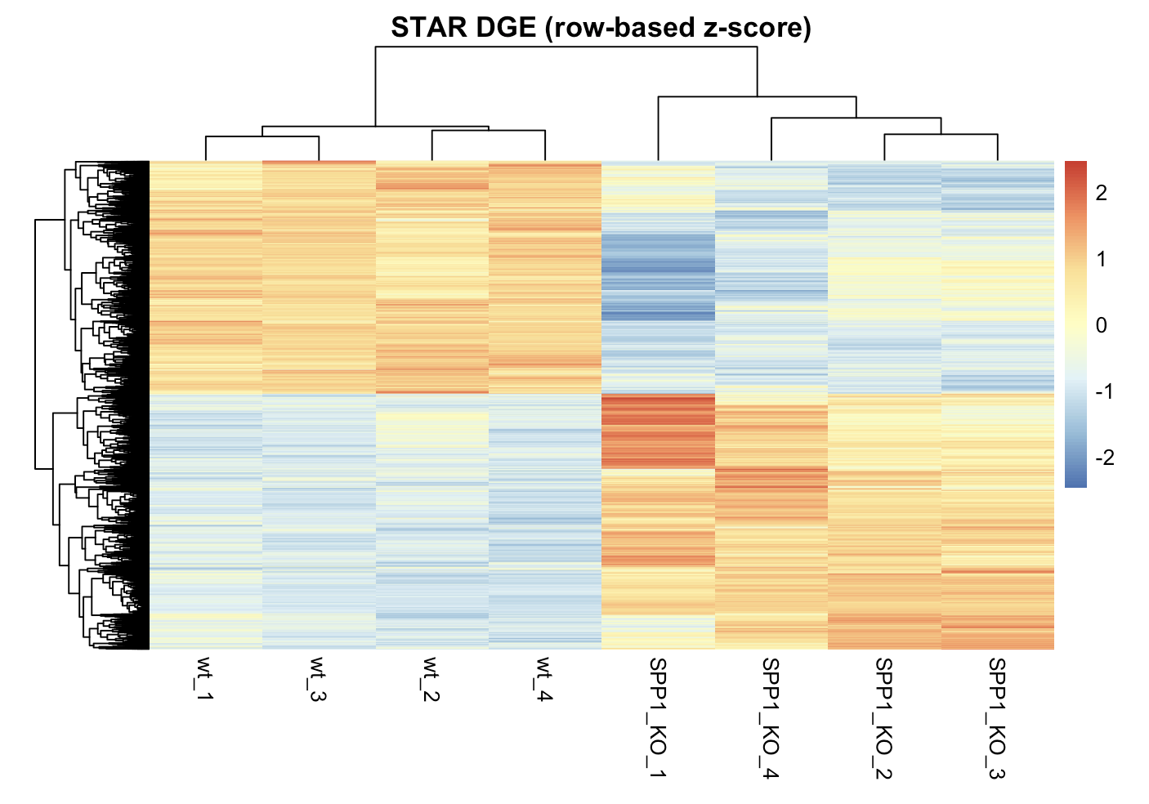
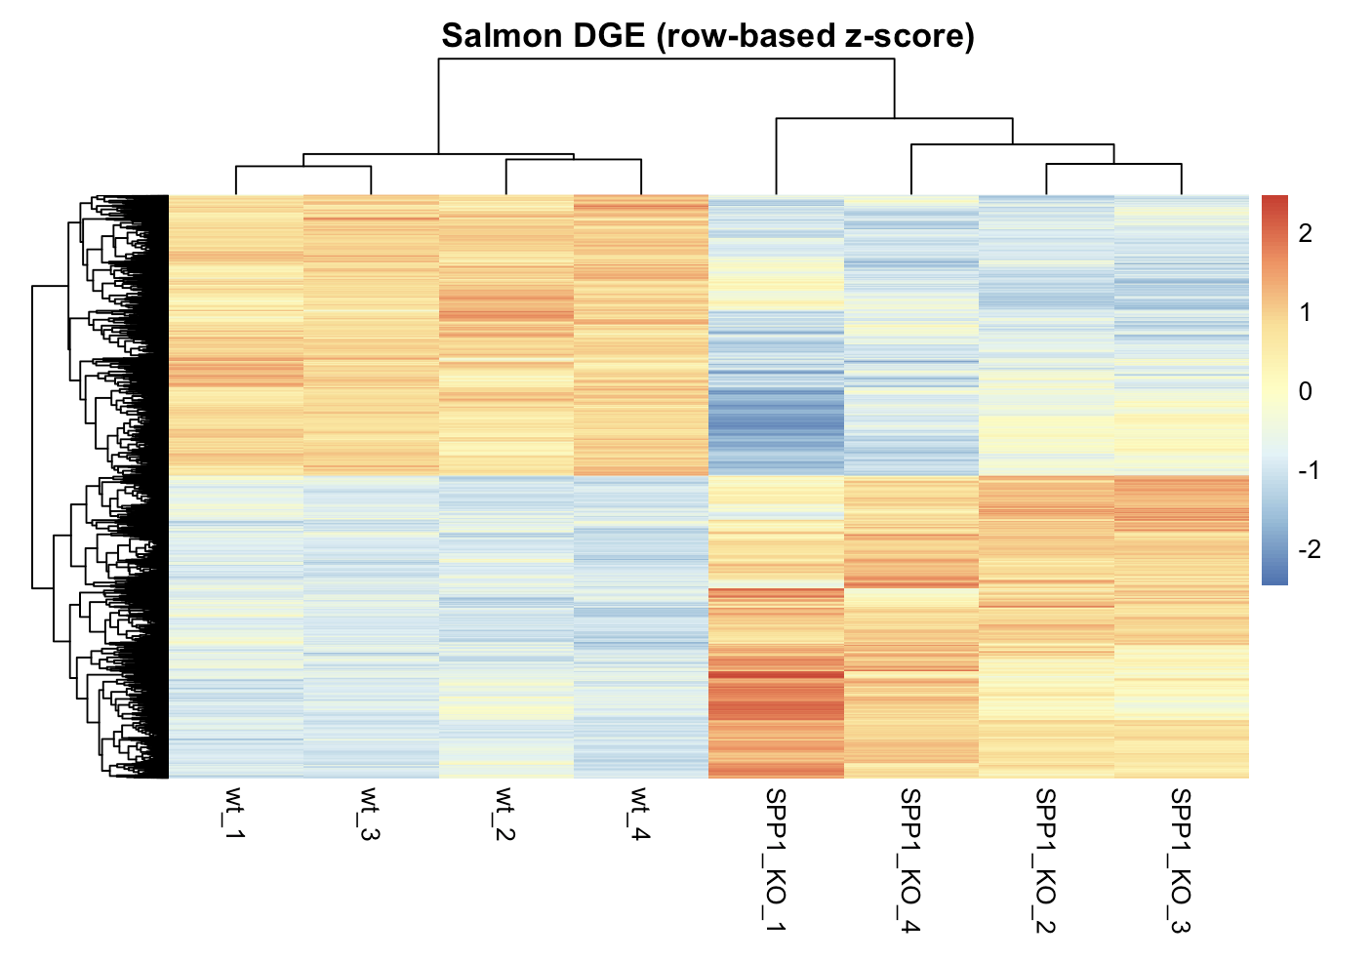
DESeq

Slide 19
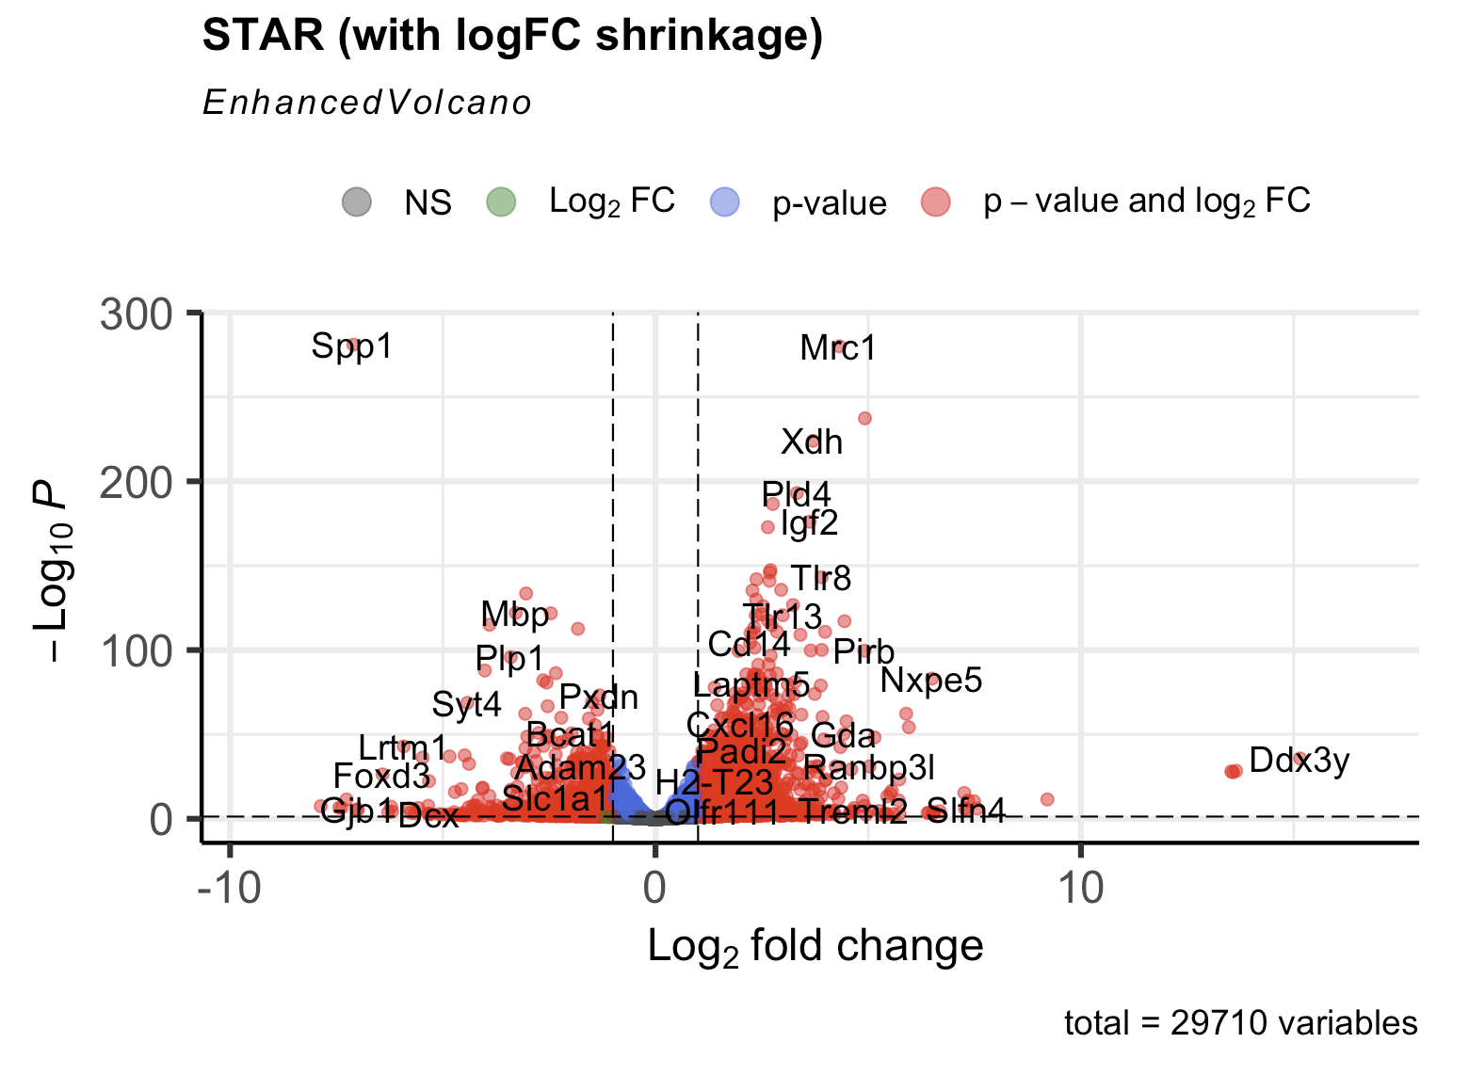
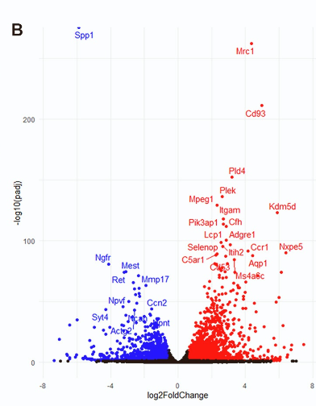
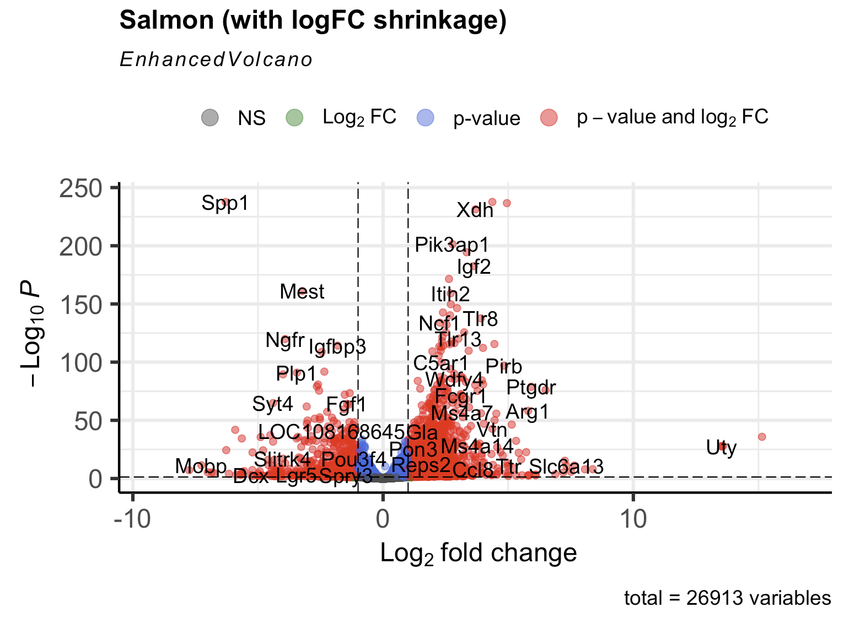
DESeq - DEGs

Slide 20
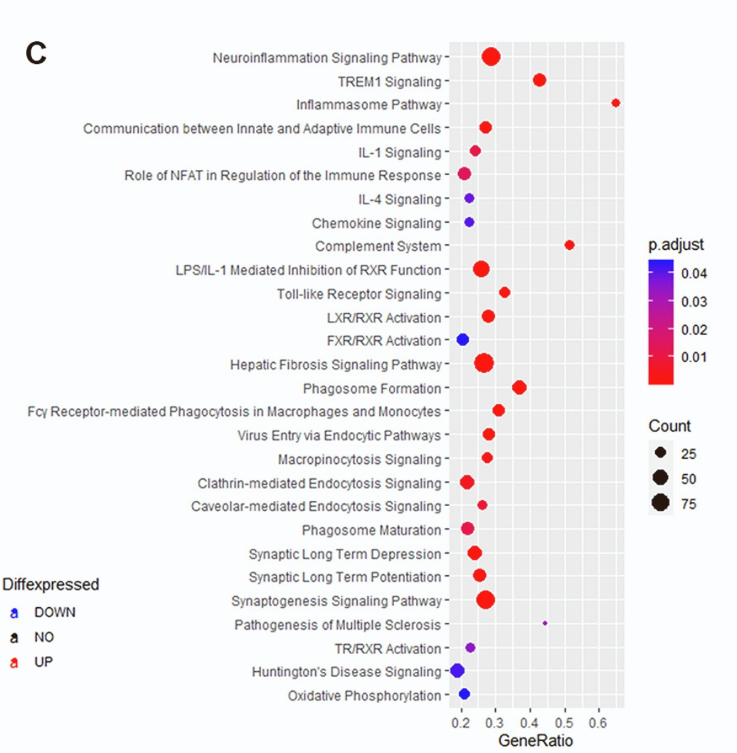
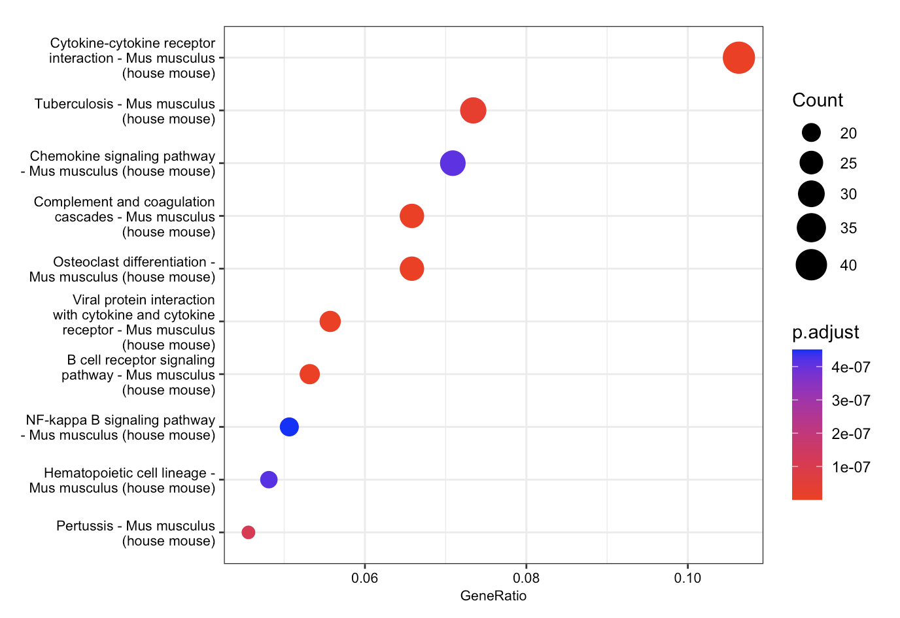
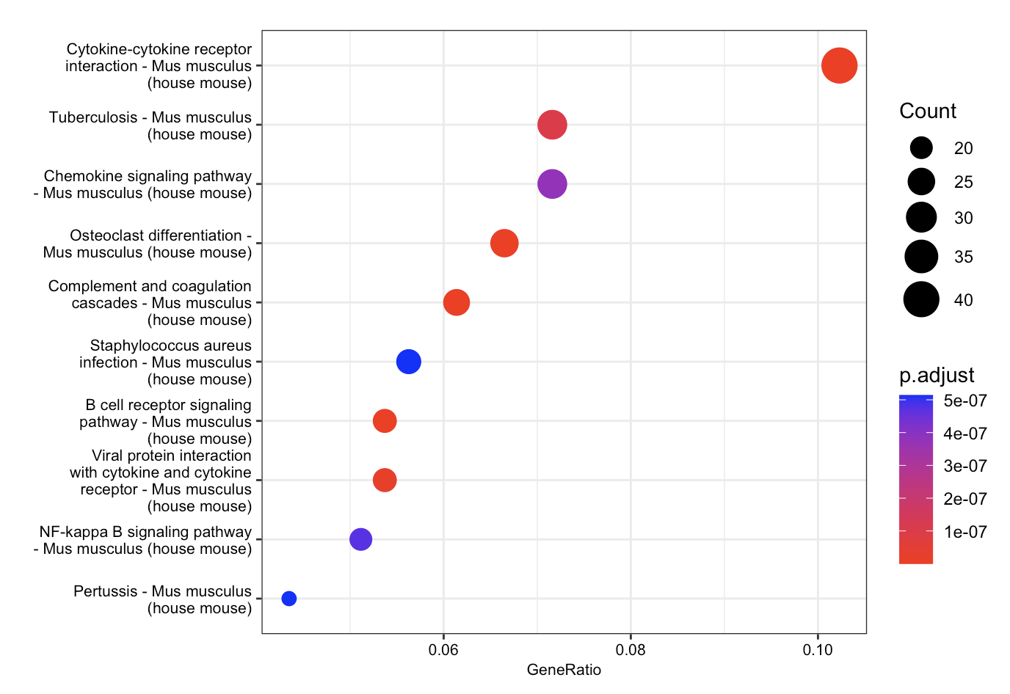
KEGG Enrichment
Li et al., 2022 Cell Reports
STAR
Salmon

Slide 21
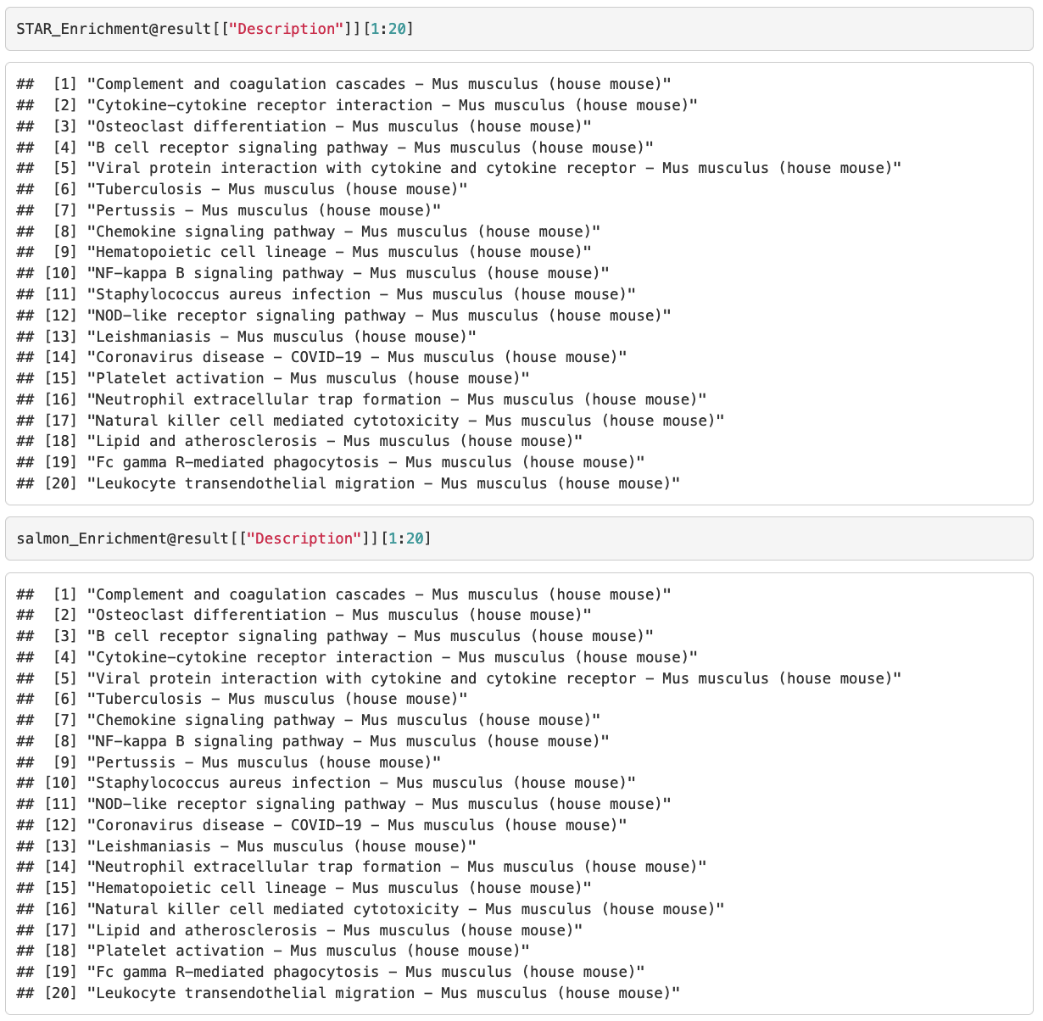
Results
At least 80% identity in the top 30 pathways

Slide 22
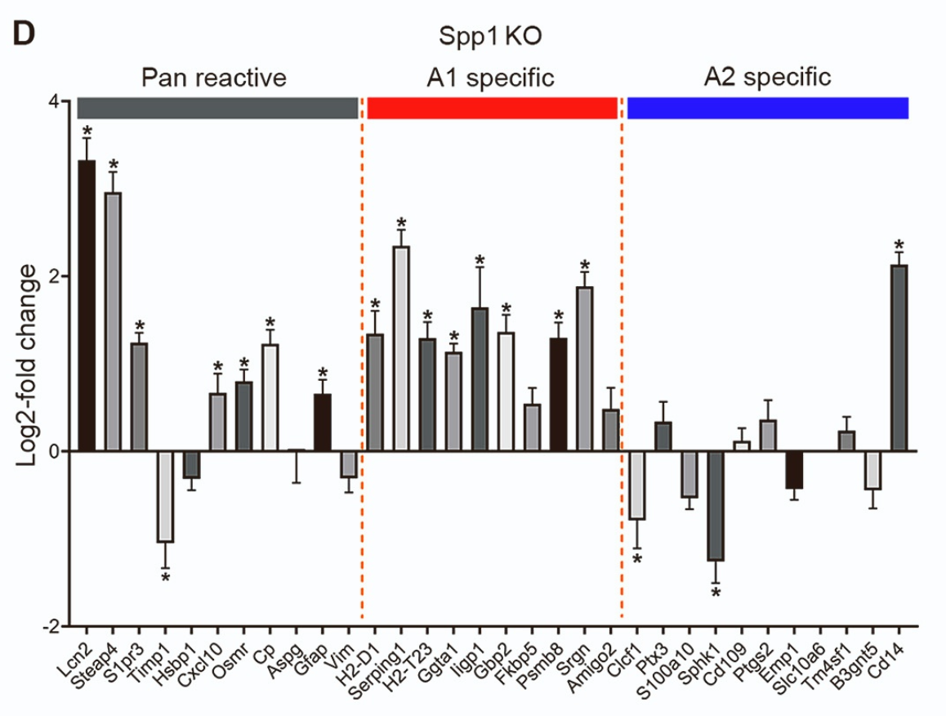
Background
‘‘pan-reactive’’ - set is commonly expressed in reactive astrocytes
‘‘A1’’ (or neuro- inflammatory) set associated with some pathological conditions (such as LPS injection)
‘‘A2’’ (or neuroprotective) set associated with other conditions, such as cerebral artery occlusion.40 In Spp1 KO astrocytes
Most pan-reactivity markers were up-regulated, as were most ‘‘A1’’ markers
Almost all markers specific for the ‘‘A2’’ neuroprotective type were down-regulated indicating that Spp1 deletion induced ‘‘A1’’ astrocytes.

Slide 23
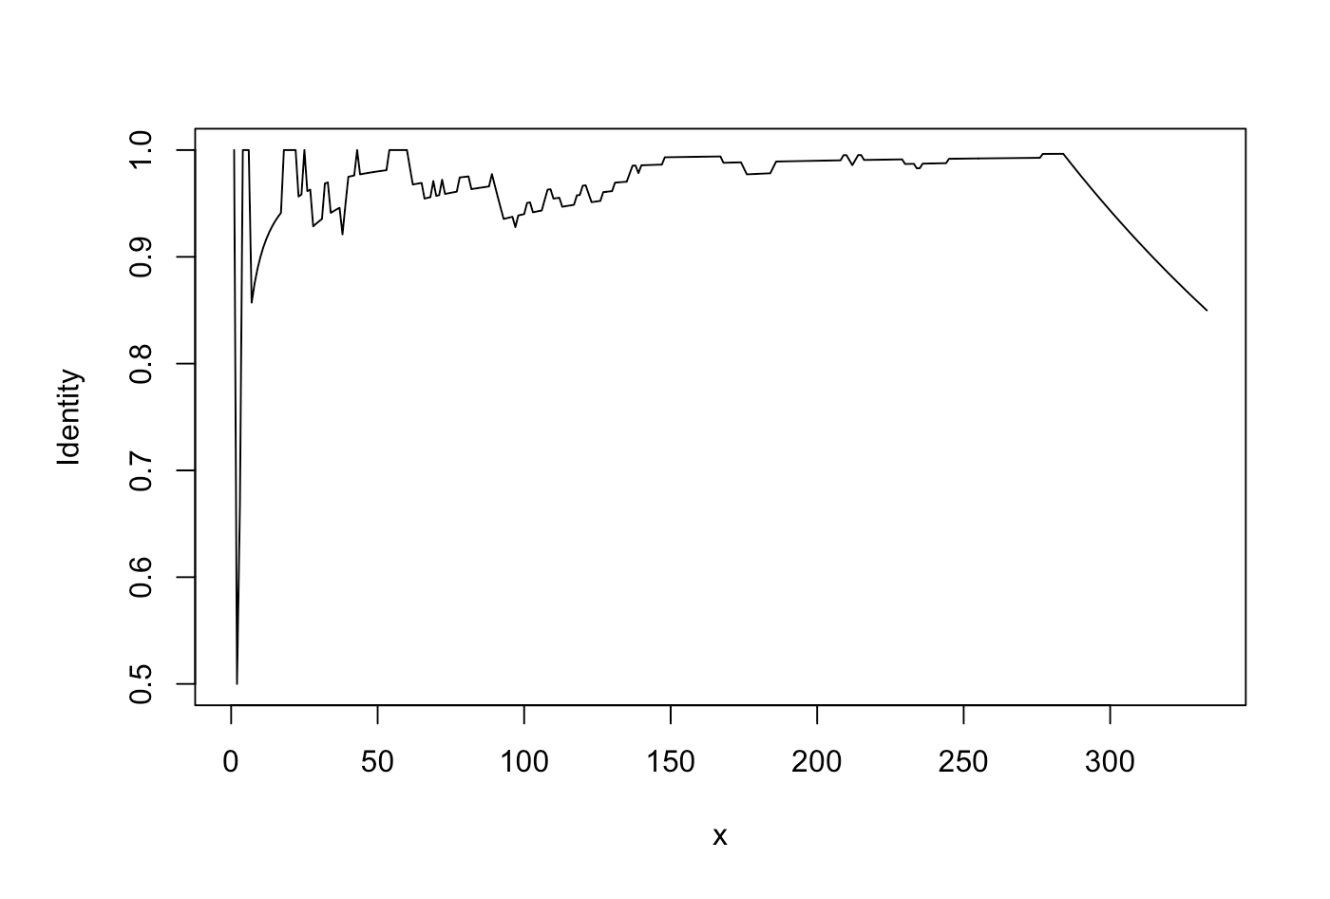
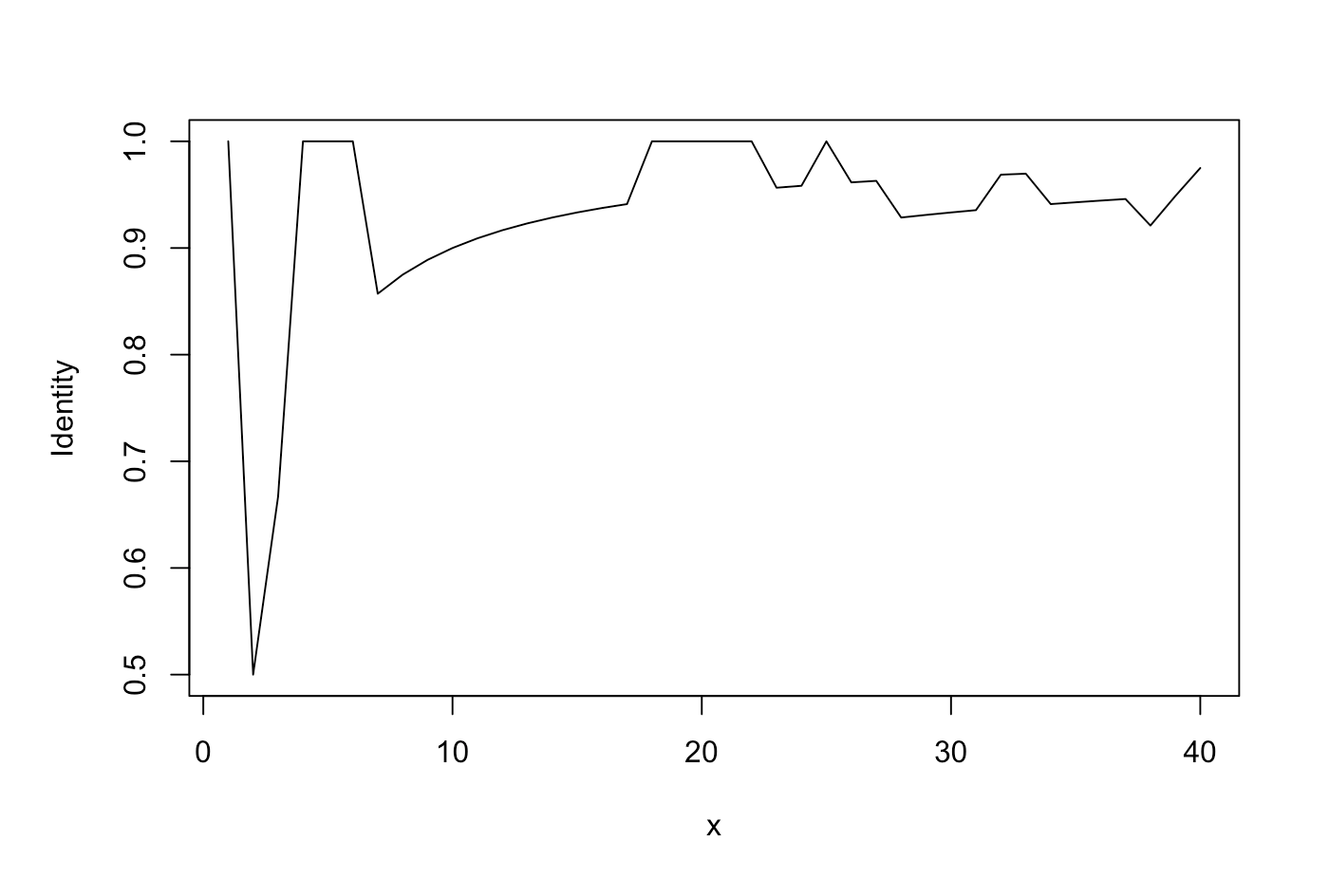
Results
Identity between STAR and Salmon Enriched pathways in the top x significant pathways

Slide 24
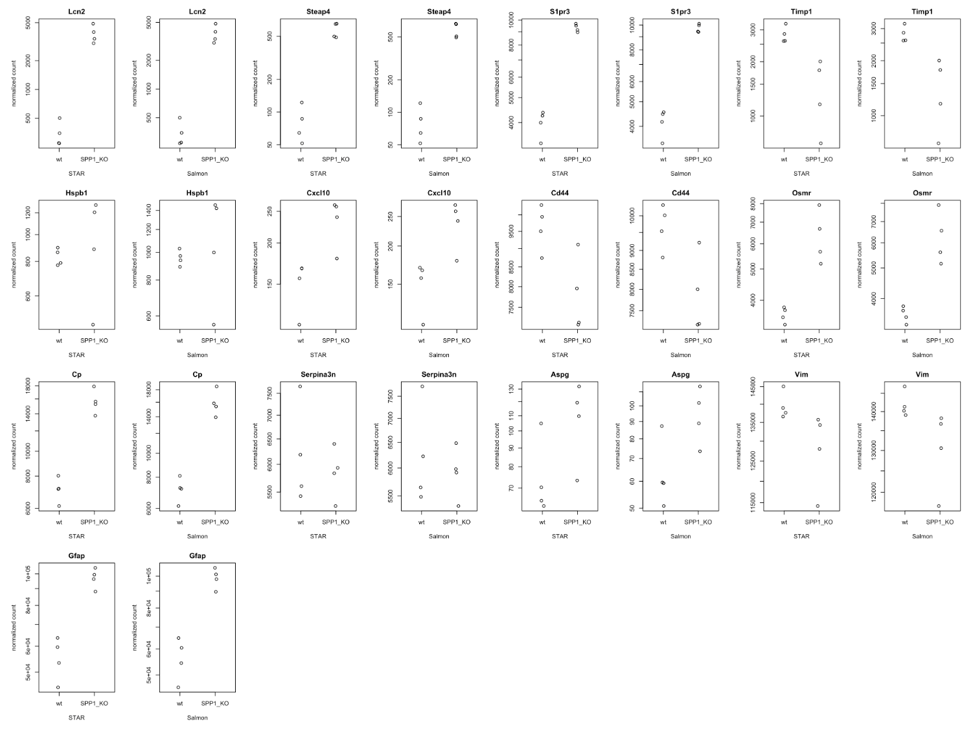
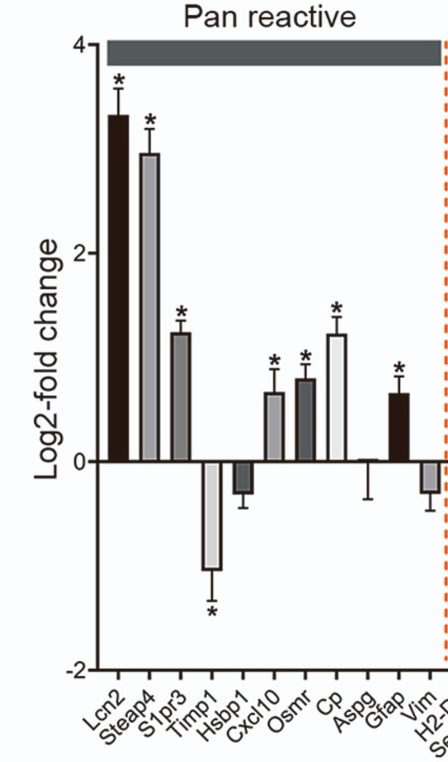
Naïve validation – Pan Reactive Genes up-regulated in SPP1_KO samples
Notes:
Pan-reactive genes are expressed at similar levels by both A1- and A2-reactive phenotypes and appear to be universal markers of astrogliosis - Astrogliosis (also known as astrocytosis or referred to as reactive astrogliosis) is an abnormal increase in the number of astrocytes due to the destruction of nearby neurons from central nervous system (CNS) trauma, infection, ischemia, stroke, autoimmune responses or neurodegenerative disease.
A1-reactive astrocytes can be strongly induced in vitro by the addition of just three microglia-produced immune effectors (TNFa, IL-1a, and C1q) to the medium [16]. Moreover, A1-reactive astrocytes produced in this manner secrete a proteinaceous toxin that kills a large assortment of neurons and oligodendrocytes. Thus, A1-reactive astrocytes appear to demonstrate harmful properties, which might damage neurons and oligodendroglia in vivo.
A2-reactive astrocytes are proposed to be neuroprotective, since they upregulate many neurotrophic factors that promote neuronal survival and tissue repair.

Slide 25
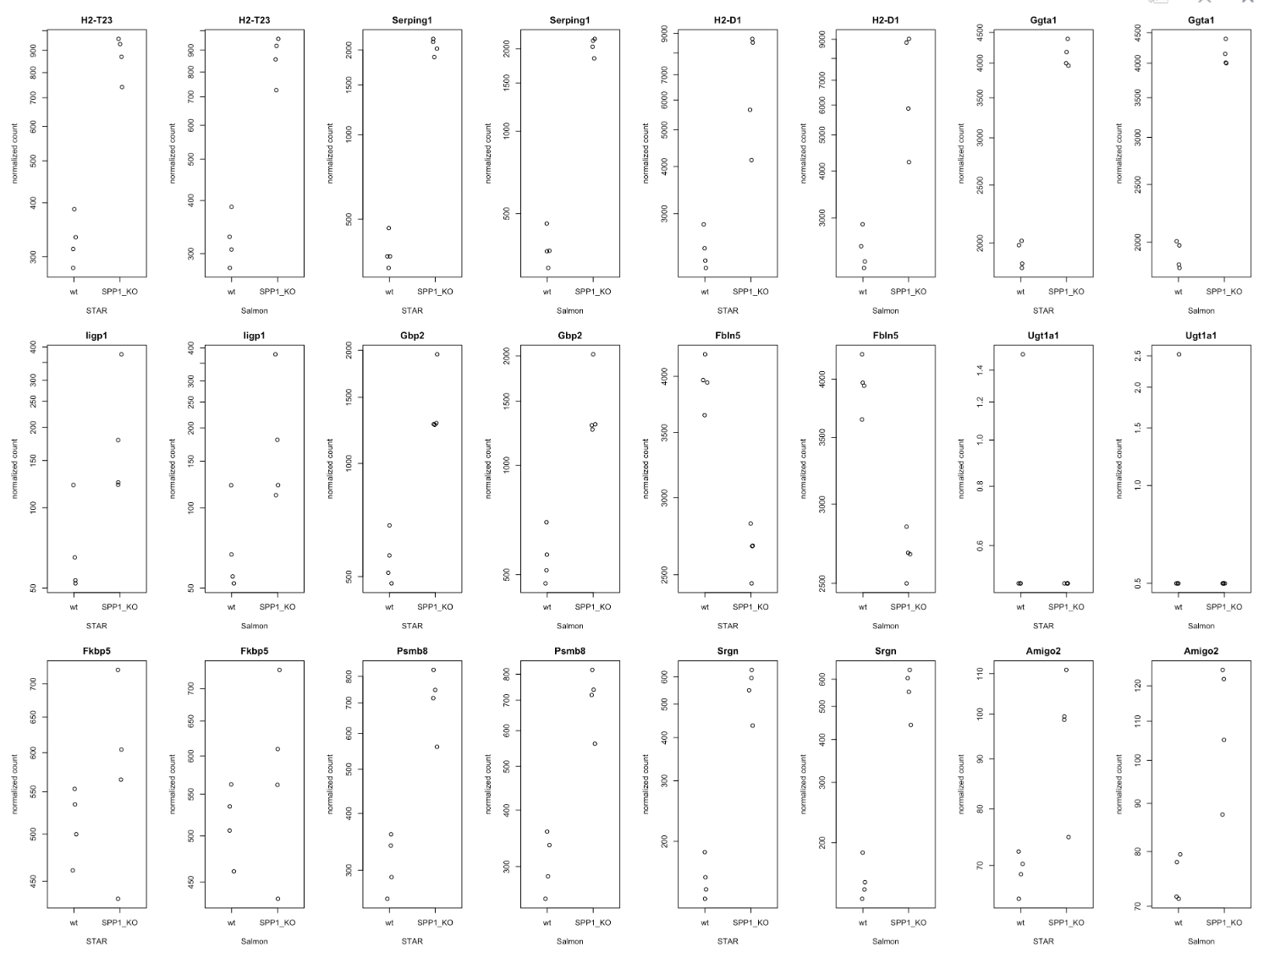
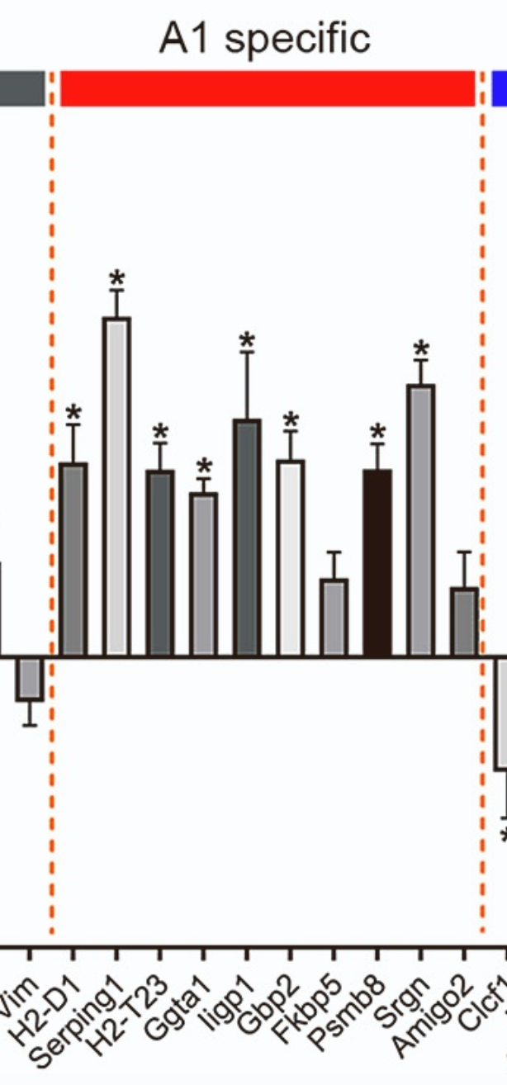
Naïve validation – A1-Specific Genes up-regulated in SPP1_KO samples
Notes:
A1-reactive astrocytes can be strongly induced in vitro by the addition of just three microglia-produced immune effectors (TNFa, IL-1a, and C1q) to the medium [16]. Moreover, A1-reactive astrocytes produced in this manner secrete a proteinaceous toxin that kills a large assortment of neurons and oligodendrocytes. Thus, A1-reactive astrocytes appear to demonstrate harmful properties, which might damage neurons and oligodendroglia in vivo.

Slide 26
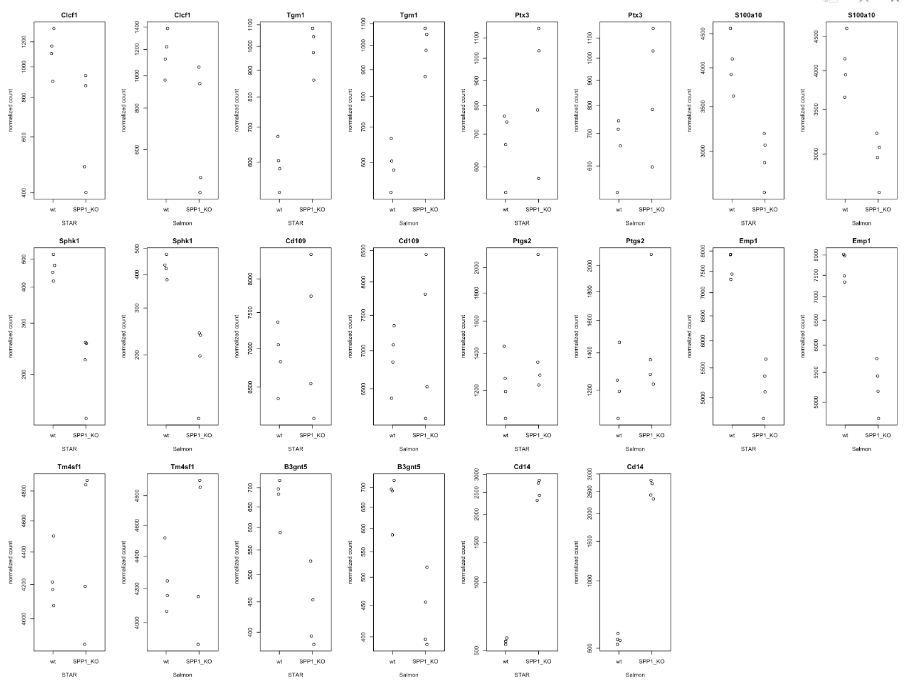
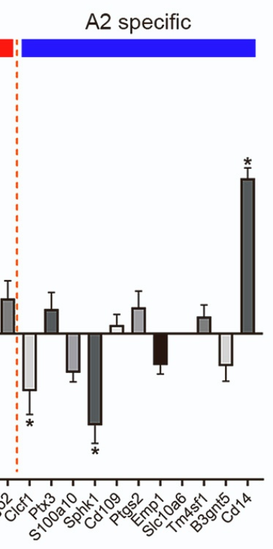
Naïve validation – A2-Specific Genes down-regulated in SPP1_KO samples
Notes:
A2-reactive astrocytes are proposed to be neuroprotective, since they upregulate many neurotrophic factors that promote neuronal survival and tissue repair.

Slide 27
Conclusions
There appears to be no significant difference between the end results of both the algorithms when considering this functionality (Differential Gene Expression Analysis)
These results might be limited to well studied genomes. More research needs to be done on organisms that have not been indexed fully/do not have a fully sequenced genome
Conducting Gene Ontology assessment requires prior knowledge about the over-represented pathways that pop-up in certain genomes often, making a note of these GO terms while interpreting the results of GO enrichment will keep one from being misled due to these biases
Further well-thought-out GO analysis should be conducted on this dataset
Limitations of this dataset:
The authors did not disclose what kind of pathway analysis they’ve performed in the paper. This led to a lot of confusion due to a mismatch between my results and the paper’s, post-EnrichKEGG using clusterProfiler
The authors also did not mention dealing with over-represented pathways based on the gene-ratio bias
The RNA-Seq analysis for this paper was delegated to the bioinformatics-core in Harvard explaining why the finer details for this analysis were not provided

Slide 28
Discussion/Problems Encountered
While creating an index using the “knowngene” version of the .gtf file lead to counting just the transcripts and not the genes since this file did not contain any gene_ids. I dealt with this problem by re-indexing the mm10 genome for both the algorithms using the ncbiRefSeq.gtf file from the UCSC table browser.
Performing the Gene Ontology analysis on the DESeq data turned out to be misleading since I did not apply the log2FC cutoff of 1.5. I corrected this by filtering out genes which have less than 1.5 log2FC
Adding the log2FC filter did not help produce identical pathway enrichment results displayed in the paper

Slide 29
Datasets
GTF (ncbiRefSeq): https://hgdownload.soe.ucsc.edu/goldenPath/mm10/bigZips/genes/mm10.ncbiRefSeq.gtf.gz
mm10 fasta file: http://ftp://hgdownload.soe.ucsc.edu/goldenPath/mm10/bigZips/mm10.fa.gz
GEO Dataset: https://www.ncbi.nlm.nih.gov/geo/query/acc.cgi?acc=GSE174522
Metadata TSV file: https://www.ebi.ac.uk/ena/browser/view/PRJNA730426
Research Article: https://doi.org/10.1016/j.celrep.2022.111880
Link to GitHub repository containing detailed report: https://github.com/moa4020/STARvsSalmon.git
Link to this presentation: https://medcornell-my.sharepoint.com/:p:/g/personal/moa4020_med_cornell_edu/EUIEJO19yf5FhxZ7XxZYIUYBt44jjSELDMdcYBWYeqYI7g?e=SJ0KZH

Slide 30
References
Srivastava A, Malik L, Sarkar H, et al. Alignment and mapping methodology influence transcript abundance estimation. Genome Biol. 2020;21(1):239. Published 2020 Sep 7. doi:10.1186/s13059-020-02151-8
Bray NL, Pimentel H, Melsted P, Pachter L. Erratum: Near-optimal probabilistic RNA-seq quantification. Nat Biotechnol. 2016;34(8):888. doi:10.1038/nbt0816-888d
Bray NL, Pimentel H, Melsted P, Pachter L. Near-optimal probabilistic RNA-seq quantification [published correction appears in Nat Biotechnol. 2016 Aug 9;34(8):888]. Nat Biotechnol. 2016;34(5):525-527. doi:10.1038/nbt.3519
Corchete LA, Rojas EA, Alonso-López D, De Las Rivas J, Gutiérrez NC, Burguillo FJ. Systematic comparison and assessment of RNA-seq procedures for gene expression quantitative analysis. Sci Rep. 2020;10(1):19737. Published 2020 Nov 12. doi:10.1038/s41598-020-76881-x
Li S, Jakobs TC. Secreted phosphoprotein 1 slows neurodegeneration and rescues visual function in mouse models of aging and glaucoma. Cell Rep. 2022;41(13):111880. doi:10.1016/j.celrep.2022.111880

